Slide 1
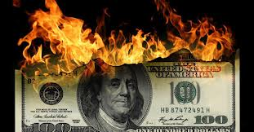
Financial Technology: Algorithmic Trading and Social Media Analytics
Prof. Philip Treleaven
Director
UK Centre for Financial Computing
University College London
p.treleaven@ucl.ac.uk

Slide 2
What would you like me to cover?
Big Data Analytics
Algorithmic Trading
Flash Crashes & Rouge Algorithms
Social Media Analytics
…

Slide 3
Big Data Analytics

Slide 4



Doctoral Training Programme
600-700 enquiries/applications pa
Intake 15-20 PhD students
Year 1 Masters of Research (MRes)
Years 2-4 Applied PhD
Student can be registered in any department at UCL or LSE (Computer Science, Statistics, Maths, Economics …)
Each student has an Academic Supervisor and an Industry Adviser.
Student has an industrial partner and works at partner from 6 months to 3 years.

Slide 5
UK Centre for Financial Computing
80 PhD Students
Computational Finance
  Work with DB, BAML, BNP Paribas, Man, BarCap, Citi, HSBC …
  Algorithmic Trading
  Risk Management etc.
Computational Retail
  Customer Analytics
  Loyalty cards
Computational Advertising
  Recommender Systems
Computational Healthcare
  Boots eHealthcare
  3D Healthcare
Computational Sport
  Performance Enhancement
  Talent Identification
5

Slide 6

Algorithmic Trading
The industrialisation of trading

Slide 7
Algorithmic Trading Definition
Algorithmic trading is an ‘arms race’ - 70%-75% US equity trades by volume now done by algorithms.
Algorithmic trading is the use of computer programs to automate one or more stages of the trading process: pre-trade analysis (data analysis), trading signal generation (what to trade), and trade execution (when and how to trade).
High-Frequency trading is the execution of computerized trading strategies characterized by extremely short position-holding periods.
Each stage of this trading process can be conducted by:
  by humans
  by algorithms + humans (e.g. low frequency trading)
  fully by algorithms (e.g. high-frequency trading)

Slide 8
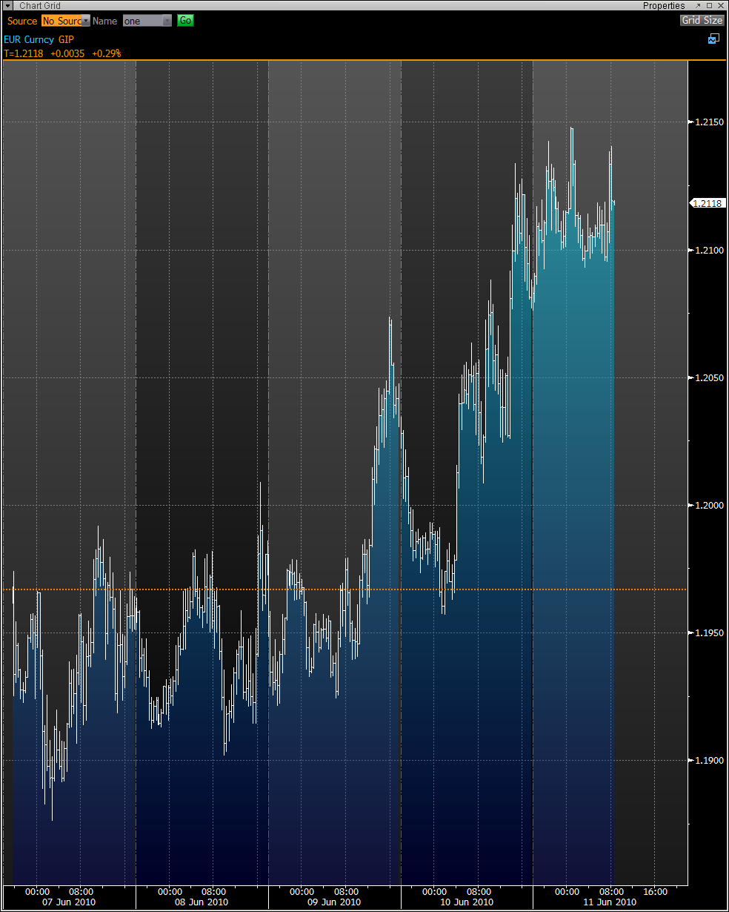
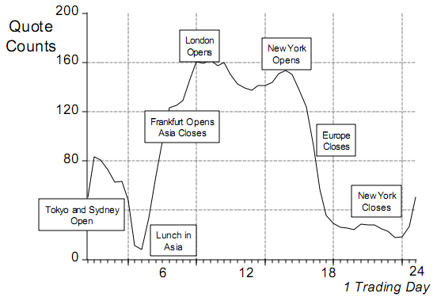
Market Microstructure
The graph shows the intra-day price of EUR/USD.
EUR/USD is a very liquid currency with tight spreads.
Difficult to predict as is very heavily traded, often the driver for other currency pair movements.
© John Loizides, Citi

Slide 9
Algorithmic Trading Requirements
Centralise Order Book – shared centralized order book that lists the buy and sell orders for a specific security ranked by price and order arrival time
Markets – deployed for highly liquid markets and (typically) high-frequency trading (equities, futures, derivatives, bonds, FX
Systems – AT systems have three broad sources:
  In-house systems - to support their proprietary trading and market-making.
  Client systems - systems for banks’ clients to use.
  Vendor systems - off-the-shelf and bespoke AT system.
Information Exchange – central to the operation of these systems are financial protocols (so-called Financial Information eXchange FIX Protocol)

Slide 10
Centralised Order book - Orders, stacks & matching
  Order types:
    market order (immediately)
    limit order (specific price)
    iceberg order (large single order that has been divided into smaller lots)
  Time in force:
    day order (valid only for less than a day)
    good-till-cancelled (valid until executed or cancelled)
    fill-or-kill (immediately execute or cancel)
  Conditional orders:
    stop order (to sell (buy) when the price of a security falls (rises) to a designated level)
    stop limit order (executed at the exact price or better)
  Discretionary order (broker decides when and price)
113.13
1255
Offers
(Prices & Quantity)
113.12
480
113.11
825
Market Touch
113.10
600
113.09
725
Bids
(Prices & Quantity)
113.08
150
Detailed view of 113.10 stack:
113.10
5
370
13
212
User A
User B
User …
User …
Any sell market-order will first trade with User A, then User B, etc…
Any new buy limit-order at 113.10 will join the stack at the back of the queue
Notes:
Market order
A market order is a buy or sell order to be executed by the broker immediately at current market prices. As long as there are willing sellers and buyers, a market order will be filled.
A market order is the simplest of the order types. Once the order is placed, the customer has no control over the price at which the transaction is executed. The broker is merely supposed to find the best price available at that time. In fast-moving markets, the price paid or received may be quite different from the last price quoted before the order was entered.[1]
A market order for a large number of shares may be split by the broker across multiple participants on the other side of the transaction, resulting in different prices for some of the shares.
Limit order
A limit order is an order to buy a security at no more (or sell at no less) than a specific price. This gives the customer some control over the price at which the trade is executed, but may prevent the order from being executed ("filled").[2]
A buy limit order can only be executed by the broker at the limit price or lower. For example, if an investor wants to buy a stock but doesn't want to pay more than $20 for the stock, the investor can place a limit order to buy the stock at any price up to $20. By entering a limit order rather than a market order, the investor will not be caught buying the stock at $30 if the price rises sharply.
A sell limit order can only be executed at the limit price or higher.
A limit order to buy may never be executed if the market price surpasses the limit before the order can be filled. Because of the added complexity, some brokerages will charge more for executing a limit order than they would for a market order and may make additional charges if the order goes unfulfilled.
Both buy and sell orders can be additionally constrained. Two of the most common additional constraints are Fill Or Kill (FOK) and All Or None (AON). FOK orders are either filled (partially or completely) on the first attempt or canceled outright, while AON orders stipulate that the order must be completely filled or not filled at all (but still held on the order book for later execution).
Time in force
A day order (the most common) is good only for one day. It is in force from when it is entered to the end of regular trading on the same day. A day order is assumed unless another type is specified.
A good-till-cancelled order requires a specific cancelling order. It can persist indefinitely (although brokers may set some limit, for example, 90 days). This is good for when the investor wishes to sit on the beach for a few weeks.
Most markets have single-price auctions at the beginning ("open") and the end ("close") of regular trading. An order may be specified on the close or on the open, then it is entered in an auction but has no effect otherwise. There is often some deadline, for example, orders must be in 20 minutes before the auction. They are single-price because all orders, if they transact at all, will transact at the same price, the open price and the close price respectively.
Combined with price instructions, this gives market on close (MOC), market on open (MOO), limit on close (LOC), and limit on open (LOO). For example, a market-on-open order is guaranteed to get the open price, whatever that is; a buy limit-on-open order will be filled if the open price is lower, will not be filled if the open price is higher, and may or may not be filled if the open price is the same.
Fill-or-kill orders are usually limit orders that must be executed or cancelled immediately.
Conditional orders
A conditional order is any order other than a limit order that requires the broker to check whether a specific condition has been met.
Stop orders
A stop order (also stop loss order) is an order to buy (or sell) a security once the price of the security has climbed above (or dropped below) a specified stop price. When the specified stop price is reached, the stop order is entered as a market order (no limit).
With a stop order, the customer does not have to actively monitor how a stock is performing. However, because the order is triggered automatically when the stop price is reached, the stop price could be activated by a short-term fluctuation in a security's price. Once the stop price is reached, the stop order becomes a market order. In a fast-moving market, the price at which the trade is executed may be much different from the stop price. The use of stop orders is much more frequent for stocks, and futures, that trade on an exchange than in the over-the-counter (OTC) market.
A sell stop order is an instruction to sell at the best available price after the price goes below the stop price. A sell stop price is always below the current market price. For example, if an investor holds a stock currently valued at $50 and is worried that the value may drop, he/she can place a sell stop order at $40. If the share price drops to $40, the broker will sell the stock at the next available price. This can limit the investor's losses (if the stop price is at or below the purchase price) or lock in some of the investor's profits.
A buy stop order is typically used to limit a loss (or to protect an existing profit) on a short sale.[3] A buy stop price is always above the current market price. For example, if an investor sells a stock short hoping the stock price goes down in order to give the borrowed shares back at a lower price (Covering), the investor may use a buy stop order to protect himself against losses if the price goes too high.
A stop limit order combines the features of a stop order and a limit order. Once the stop price is reached, the stop-limit order becomes a limit order to buy (or to sell) at no more (or less) than a specified price.[4] As with all limit orders, a stop-limit order will not get filled if the security's price never reaches the specified limit price.
A trailing stop order is entered with a stop parameter that creates a moving or trailing activation price, hence the name. This parameter is entered as a percentage change or actual specific amount of rise (or fall) in the security price. Trailing stop sell orders are used to maximize and protect profit as a stock's price rises and limit losses when its price falls. Trailing stop buy orders are used to maximize profit when a stock's price is falling and limit losses when it is rising.
For example, a trader has bought stock ABC at $10.00 and immediately places a trailing stop sell order to sell ABC with a $1.00 trailing stop. This sets the stop price to $9.00. After placing the order, ABC doesn't exceed $10.00 and falls to a low of $9.01. The trailing stop order is not executed because ABC has not fallen $1.00 from $10.00. Later, the stock rises to a high of $15.00 which resets the stop price to $14.00. It then falls to $14.00 ($1.00 from its high of $15.00) and the trailing stop sell order is entered as a market order.
A trailing stop limit order is similar to a trailing stop order. Instead of selling at market price when triggered, the order becomes a limit order.
Market-if-touched order
Main article: Market If Touched
A buy market-if-touched order is an order to buy at the best available price, if the market price goes down to the "if touched" level. As soon as this trigger price is touched the order becomes a market buy order.
A sell market-if-touched order is an order to sell at the best available price, if the market price goes up to the "if touched" level. As soon as this trigger price is touched the order becomes a market sell order.
One cancels other orders
One cancels other orders (OCO) are used when the trader wishes to capitalize on only one of two or more possible trading possibilities. For instance, the trader may wish to trade stock ABC at $10.00 or XYZ at $20.00. In this case, they would execute an OCO order composed of two parts: A limit order for ABC at $10.00, and a limit order for XYZ at $20.00. If ABC reaches $10.00, ABC's limit order would be executed, and the XYZ limit order would be canceled.
Tick sensitive orders
An uptick is when the last (non-zero) price change is positive, and a downtick is when the last (non-zero) price change is negative. Any tick sensitive instruction can be entered at the trader's option, for example buy on downtick, although these orders are rare.
Discretionary order
A discretionary order is an order that allows the broker to delay the execution at their discretion to try to get a better price. These are sometimes called not held orders.
Quantity and display instructions
A broker may be instructed not to display the order to the market. For example an "All-or-none" buy limit order is an order to buy at the specified price if another trader is offering to sell the full amount of the order, but otherwise not display the order. A so-called "iceberg order" requires the broker to display only a small part of the order, leaving a large undisplayed quantity "below the surface".
Electronic markets
All of the above orders could be entered into an electronic market, but simple market and limit orders are generally encouraged by order priority rules. Market orders are given greatest priority, followed by limit orders. If a limit order has priority it is the next trade that will be executed at the limit price. Simple limit orders are generally given high priority, based only on a first-come-first-served rule. Conditional orders are generally given priority based on the time the condition is met. "Iceberg orders" and "dark pool orders" (which are not displayed) are given lower priority

Slide 11
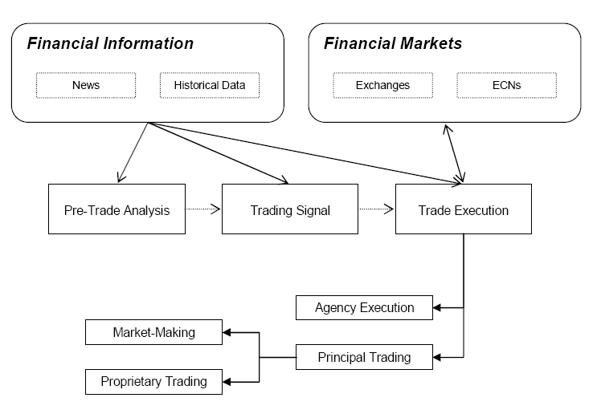
Trade Process – what, when, how
① Pre-trade analysis – analysis properties of asset using of market data or financial news.
② Trading signal – identifies trading opportunities based on the pre-trade analysis.
③ Trade execution – executing orders for the selected asset (when and how).

Slide 12
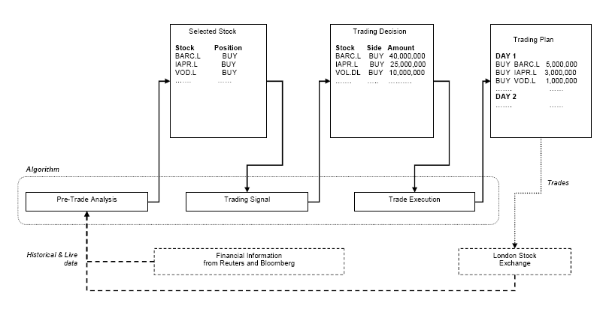
Algorithmic Trading Equities example system

Slide 13
Algorithmic/Systematic trading
Research
Data
(Real-time/Historical; market/non-market)
Pre-trade Analysis
Alpha
Model
Risk
Model
Transaction Cost Model
Trading Signal
Portfolio Construction Model
Trade Execution
Execution Model
Post-trade analysis

Slide 14
Algorithmic/Systematic trading
Implementation Issues
Research
Data
(Real-time/Historical; market/non-market)
Forecast target
Time Horizon
Pre-trade Analysis
‘Bet’ Structure
Alpha
Model
Risk
Model
Transaction Cost Model
Investment Universe
Model Specification
Trading Signal
Run Frequency
Portfolio Construction Model
Data Availability
Trade Execution
Regulation Compliance
Execution Model
Post-trade analysis

Slide 15
Alpha Trading Models - (predicting the future of instruments)
Quant Style
Theory-driven (hypothesizing the way markets behave)
Empirical Data-driven (data mining to identify behaviour)
Input
Price-data
Fundamental
Behaviour/ Sentiment
Real-time
Historical
Approach
Trend Following
Mean Reversion
Yield
Growth
Quality
Market Data
Non-market Data
Strategy
Stat Arb

Slide 16
Risk Model - selection/sizing of exposures to maximise returns
Risk Model
Limiting Amount of Risk (Exposure)
Size Limits (constraints, penalty)
Measuring Risk (standard deviation)
Volatility
Dispersion
VaR
Limiting Type of Risk
()
Theory-driven
(systematic risk)
Empirical
(using historical data)
Regime Change Risk
Exogenous Shock Risk
Endogenous Risk

Slide 17
Transaction Cost Model advising the Portfolio model on potential costs of transactions
Commissions (Fees, Clearing, Settlement)
Slippage (change in price between decision and execution)
Market Impact (order size, liquidity)
Transaction Cost
(potential)
Flat
Models
Linear
Models
Piecewise-Linear Models
Quadratic Models

Slide 18
Portfolio Construction Model
Quantitative Portfolio Construction
Rule-based Models
Optimizer Models
Equal Position Weighting
Equal Risk
Weighting
Alpha-driven Weighting
Decision-tree Weighting
Unconstrained Optimisation
Constrained Optimisation
Black-Litterman Optimisation
…
Mean variance optimisation
Expected Returns
Expected Volatility
Correlation Matrix
GARCH

Slide 19
Execution Model
Execution Model
Trading Venue
NYSE
LSE
NASDAQ
CME
LME
Execution Strategies
Aggressive/Passive
Large/Small Order
Scheduling
Routing
Order Type
Market
Limit
Time in force (day, GTC)
Conditional Orders
Discretionary Orders

Slide 20
Flash Crashes & Rouge Algorithms

Slide 21
Flash Crash – May 6, 2010
$600 billion in market value of US corporate stocks disappeared

Slide 22
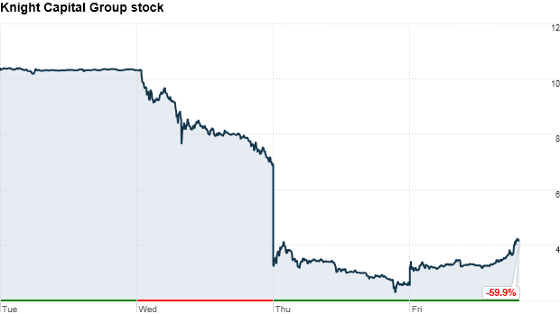
“Knightmare” – Knight Capital loose $440m
In the mother of all computer glitches, market-making firm Knight Capital Group lost $440 million in 30 minutes
One of Knight’s trading algorithms reportedly started pushing erratic trades through on nearly 150 different stocks

Slide 23

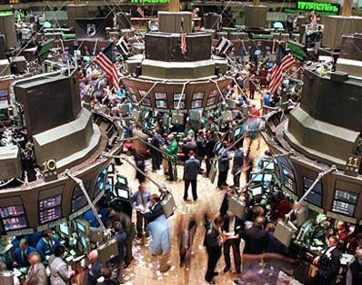
Potential for Catastrophe
Major Nuclear Explosion
Major Flash Crash

Slide 24
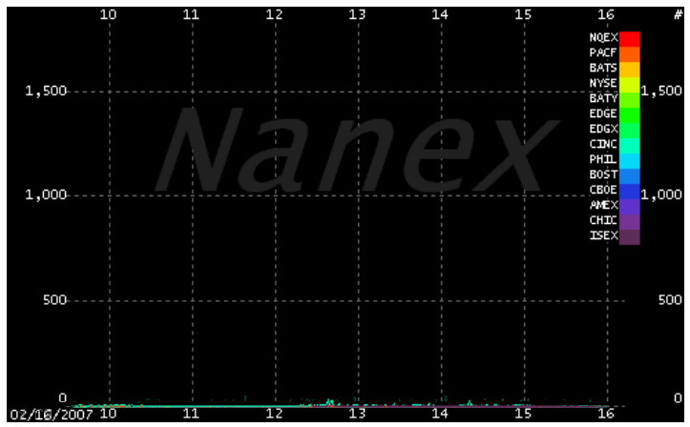
Trading volatility - 2007
This astonishing GIF comes from Nanex, and shows the amount of high-frequency trading in the stock market from January 2007 to January 2012. (Which means that the Knightmare craziness of last week is not included.)

Slide 25
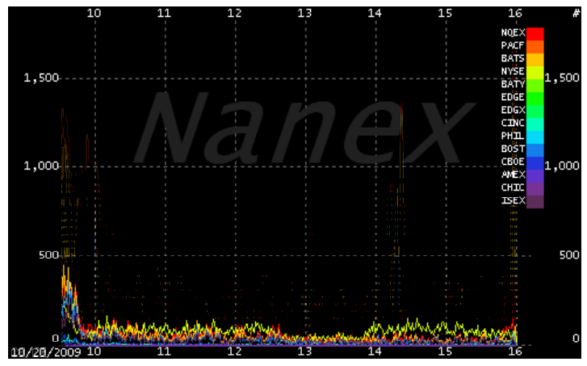
Trading volatility - 2009

Slide 26
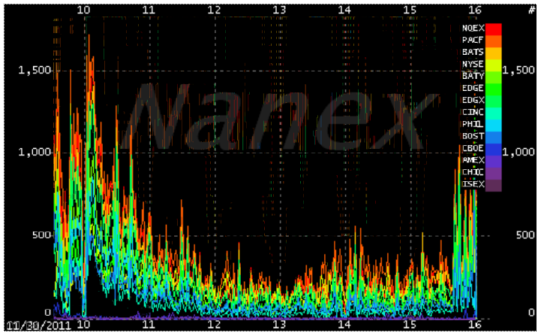
Trading volatility 2011

Slide 27
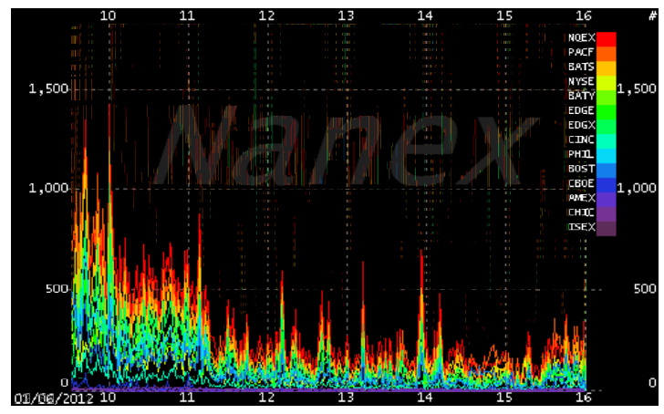
Trading volatility - 2012

Slide 28
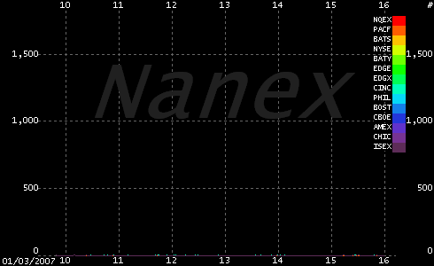
high-frequency trading in the stock market from January 2007 to January 2012

Slide 29
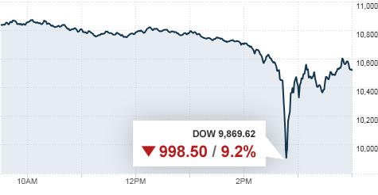
Flash Crash – May 6^{th.}
$600 billion in market value of US corporate stocks disappeared
Causes
  Fat Finger
  Stop-loss Triggering
  Inconsistent Trade Halting Rules
  Stub Quotes - ultra-low bids
  NYSE Delay
  Quote Stuffing - attempt to overwhelm a market

Slide 30
Flash Crash possible Causes
  Fat Finger in single-stock / index future
  Stop-loss Triggering
    If the market price falls through the stop loss trigger price, then the order will be activated and the long position will be automatically closed out.
  Inconsistent Trade Halting Rules
  Stub Quotes
    ultra-low bids that are placed when reserve size is depleted
  NYSE Delay
    NYSE went to “slow market” on these stocks
    Unable to access NYSE liquidity during this time
  Quote Stuffing
    attempt to overwhelm a market with excessive numbers of quotes by traders. This involves placing and then almost immediately cancelling large numbers of rapid-fire orders to buy or sell stocks
  SEC Report http://www.sec.gov/news/studies/2010/marketevents-report.pdf

Slide 31
Proposed Regulatory Changes
  Circuit breakers based on the Dow Jones Industrial Average instituted for the market following ’87 Crash
  Must quote within 30% of best price
  “Trading Pauses” for single stocks that drop 10% in 5 minute period
    Applies to all exchanges and derivatives
© Dr. Giuseppe Nuti, Citadel Securities

Slide 32
Social Media Scraping & Analytics

Slide 33











Social Media and News Data:
Social Networking sites
Blogs & Microblogs
Content Communities
Collaborative Projects
Virtual Social Worlds
News
Financial News

Slide 34
Scraping Twitter
Search API: Query Twitter for recent tweets containing specific keywords.
Streaming API: A real-time stream of tweets, filtered by userid, keyword, geographic location or random sampling.

Slide 35
Search API
One may retrieve recent tweets from the last 6-9 days containing particular keywords through Twitter’s Search API; with the following API call:
http://search.twitter.com/search.json?q=APPLE
Full documentation @ https://dev.twitter.com/docs/using-search

Slide 36
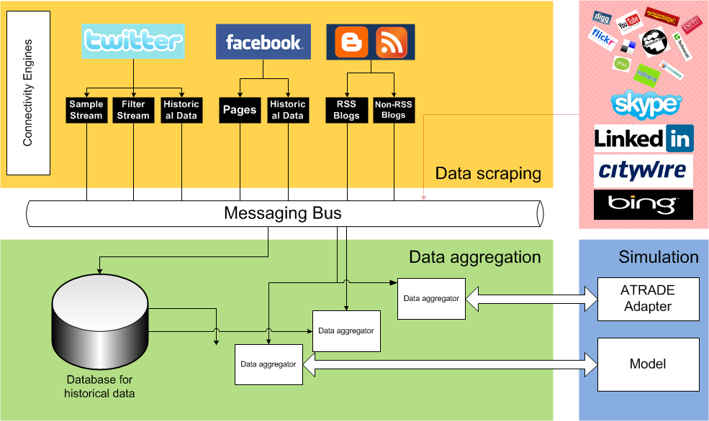
UCL Social Media Platform (SocialSTORM)
36
Notes:
Here is a high-level overview of the platform. At the top in the yellow box, there are connectors to various data sources. Those bring data from each source into the platform. In the middle of all the components we have a messaging system which is used to send data around the platform. At the bottom, in the green box is the data storage and aggregation system, and at the bottom on the right, in the blue box, is the simulation environment where simulations and models can be uploaded and run. There is also an adapter which provides UCL’s existing ATRADE platform with data. ATRADE is an algorithmic trading platform for those that haven’t heard of it and this connection potentially allows trades to made based on social data, but that’s just one use of the system.
Everything within the dotted line is what we have build as part of this project. That is, connectors for Twitter, Facebook, RSS feeds, a scraper for webpages which don’t have an RSS feed and the messaging system. The other areas outside of the dotted line are being worked on by people outside of the group project. The area in red shows connectors to data sources that are planned for future implementation.
I don’t have time to go into every component so I’ll tell you about our Twitter connector, as that is the most high volume source that we use, and the messaging system which has to transport all of the data through the platform.
36

Slide 37
Big Data Analytics
Computational Finance
  Work with DB, BAML, BNP Paribas, Man, BarCap, Citi, HSBC …
  Algorithmic Trading
  Risk Management etc.
  Agent-based models of UK banking system & systemic risk
Computational Retail
  Customer Analytics, Loyalty cards
  Pricing models
  Fashion Analytics
Computational Advertising
  Recommender Systems
Computational Healthcare
  Boots eHealthcare
  3D Healthcare
Computational Sport
  Performance Enhancement
  Talent Identification
37

